Slide 1
Comparison of the performance of three learning algorithms for verification of phishing uniform resource locator (URLs) using machine learning technique.
Kephas Loide M
201401571

Slide 2
Outline
Introduction
Research objectives
Methodology
Updated Project timeline
Visual presentation of what has been done
Problem areas
What still need to be done
Lessons learned so far

Slide 3
Introduction
Detecting phishing URLs is one of the crucial problems facing the internet community because of its high impact on the day-to-day online transactions performed.
The research aims is to train and test three mostly used learning algorithms (Naïve Bayesian, Decision Tree and Logistic Regression) to be able to detect and identify phishing URLs.
Evaluate the performance of these algorithms on the classification of phishing URLs.

Slide 4
Research objectives
Main research objective
To evaluate the performance of learning algorithms for verification of phishing URLs using machine learning techniques.
Sub-objectives of the study:
To identify the lexical features of malicious URL.
To determine which of the three algorithms a good model is for determining phishing URLs.
To apply an appropriate standard dataset to test the three learning algorithms on.
To use standard metrics for measuring the performance of the learning algorithms (Naïve Bayes classifier, Decision Tree and Logistic Regression) to benchmark the performance of the algorithms.
To verify whether a URL is a legitimate or phishing URLs.

Slide 5
Methodology
The research mainly focuses on Experiments as the approach.
Personal Extreme Programming (PXP)
Planning
Designing the model
Implementation
Testing
Iterations

Slide 6
Progress Outline
The dataset consist of 7030 URLs of which 3494 legitimate and 3536 phishing URLs .
Comparing the performance in term of accuracy, precision and recall
Building a model is completed
Identify the lexical features of malicious URL is done
Using a standard metrics for measuring the performance of the learning algorithms

Slide 7
Updated project timeline
Task Name | Task status
Supervisor Assigned | Completed
Topic Approval | Completed
Project documentation | Working progress
Literature review | Completed
Methodology | Completed
Proposal Draft | Completed
First Presentation | Completed
Requirement | Completed
Planning | Completed
Design | Completed
Implementation | Working progress
System Testing | Working progress
Retrospective | Working progress
Research Paper writing | Working progress
Final Presentation | Working progress

Slide 8
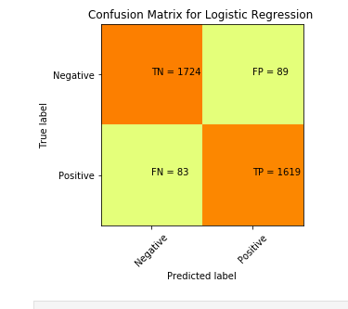
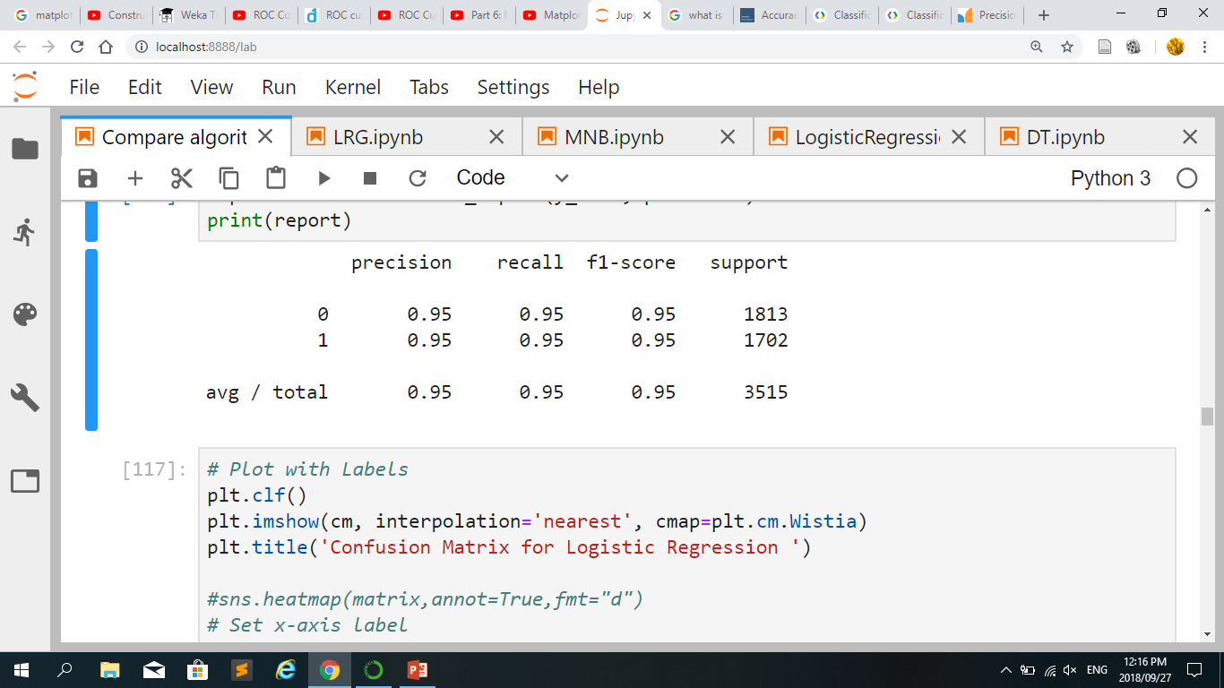
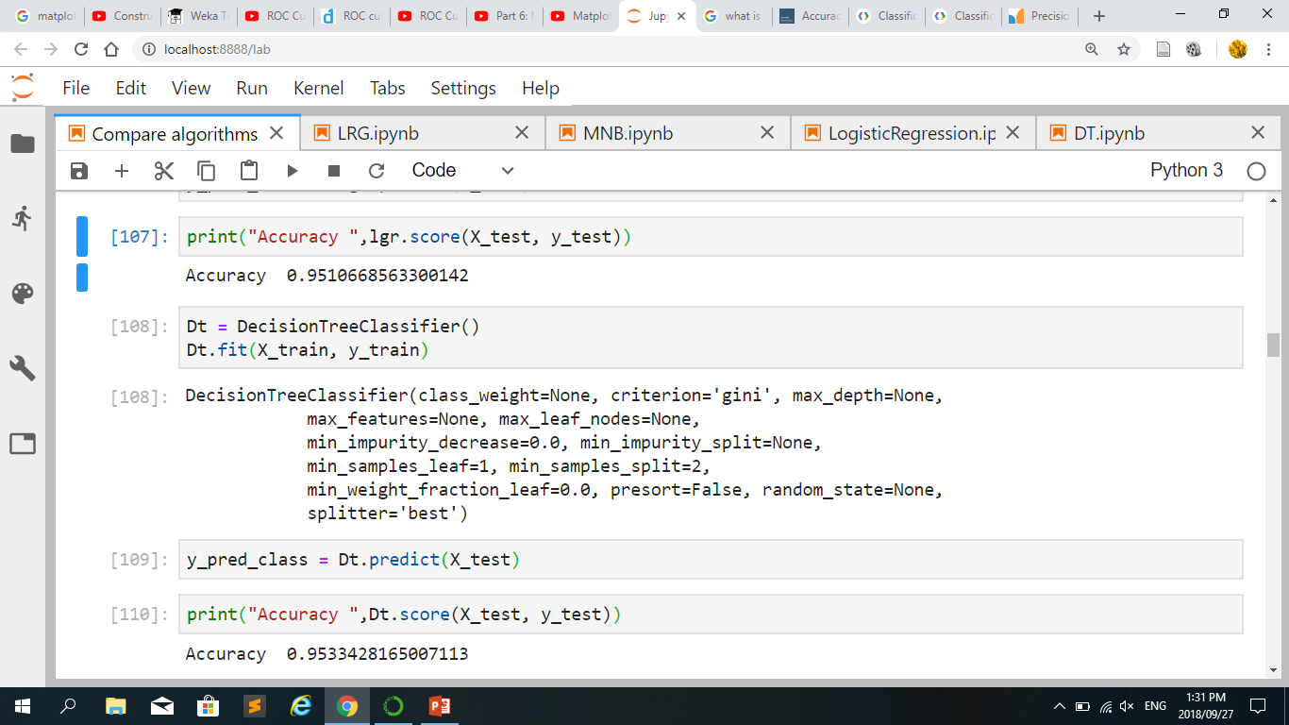
Visual presentation of what has been done

Slide 9
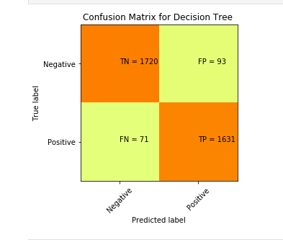
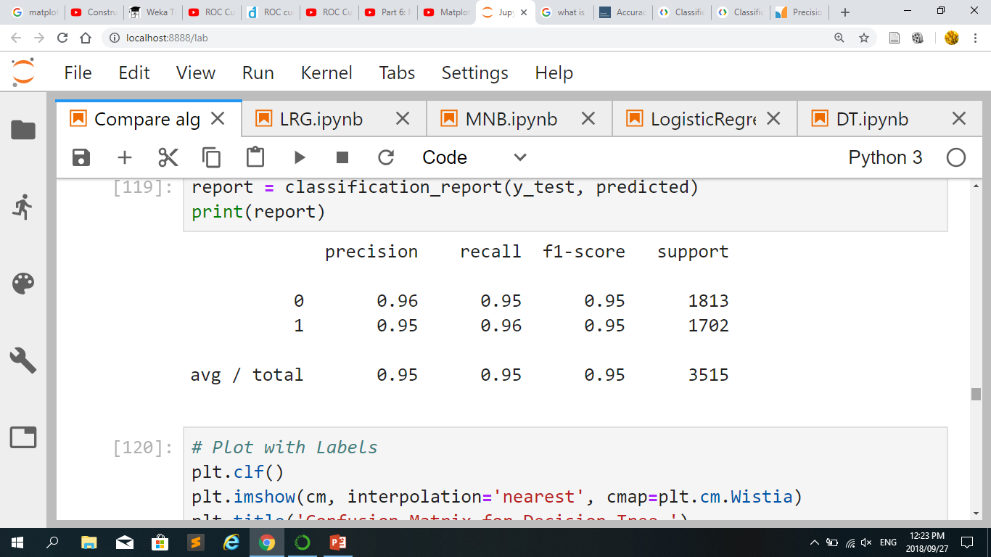
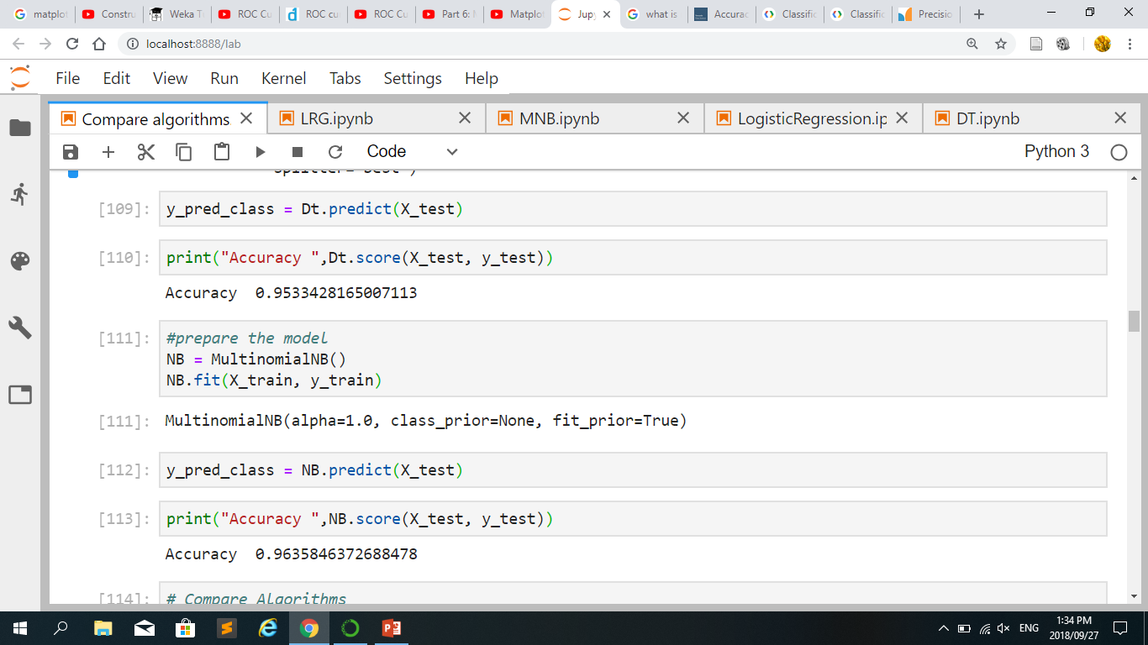
Visual presentation of what has been done

Slide 10
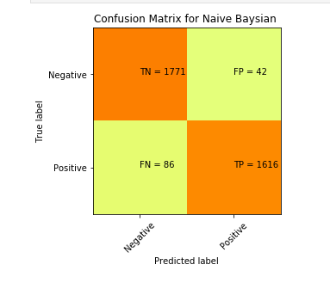
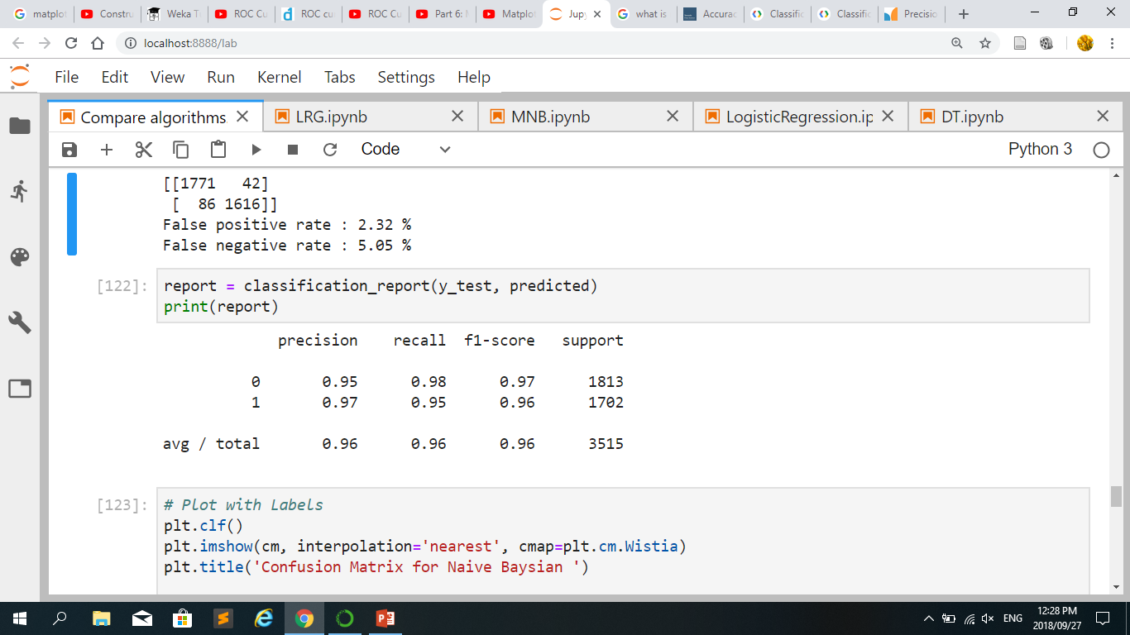
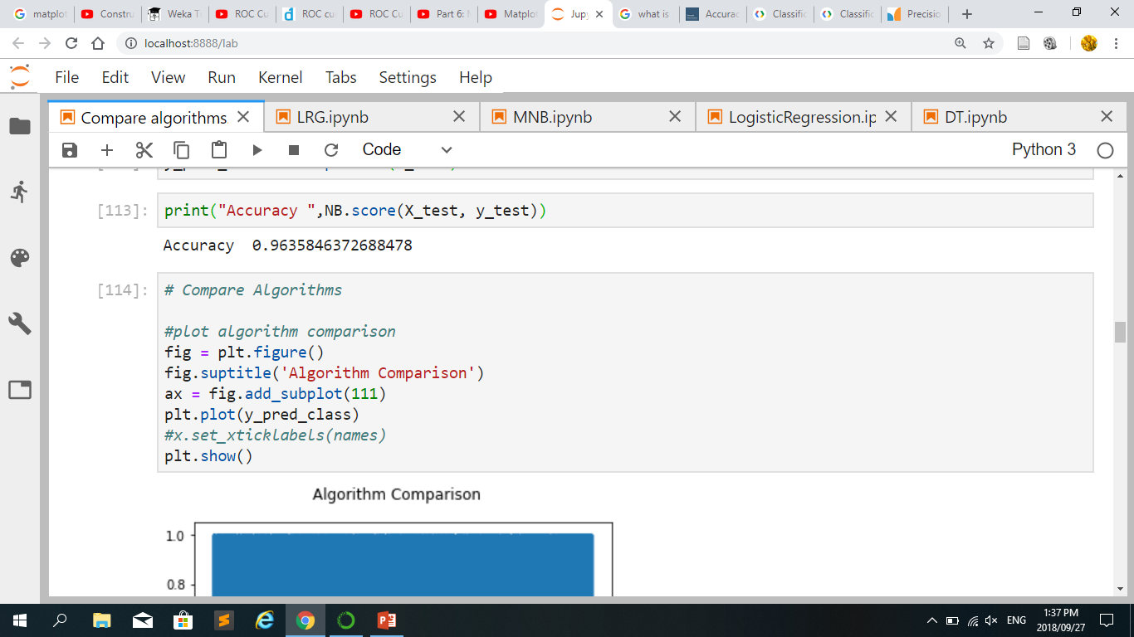
Visual presentation of what has been done

Slide 11
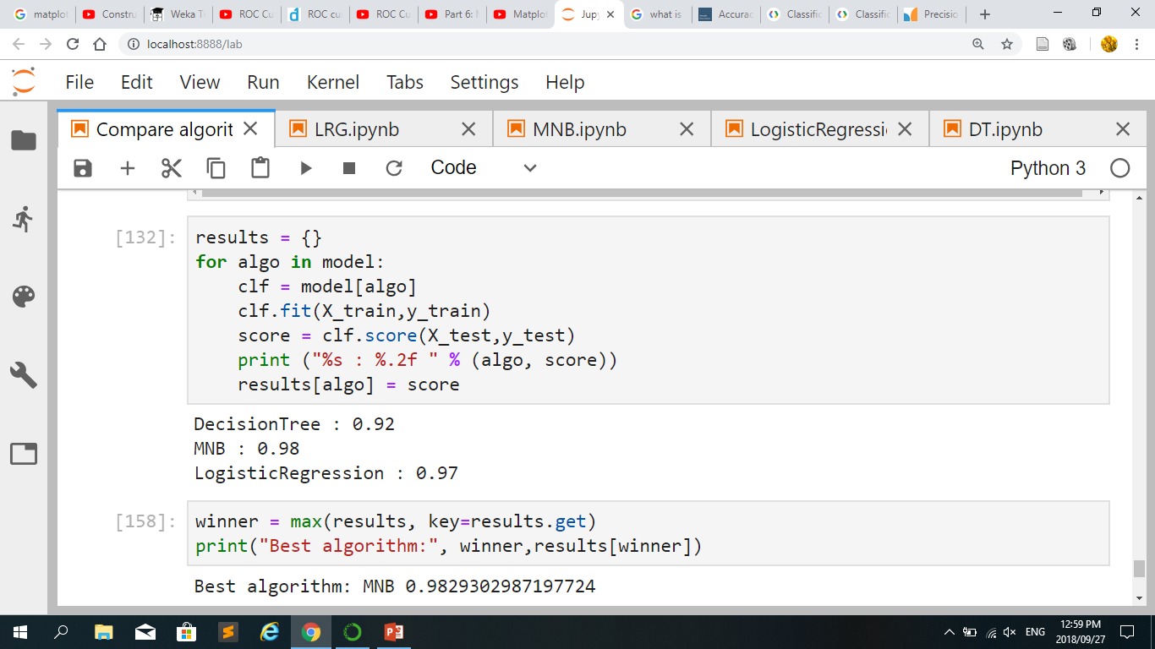
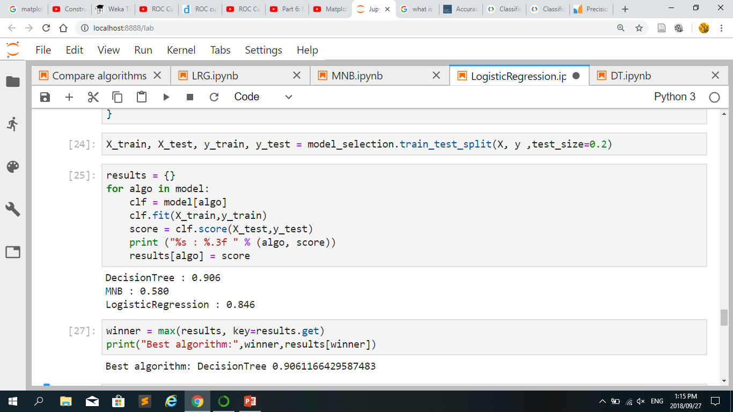
Comparison of the models with different URLs feature

Slide 12
Problem areas
Some of the lexical feature are not standard defined as phishing URLs feature.
Overfitting resolved
Graphing precision and Recall

Slide 13
Still to be completed
Testing the models
Analysing of the results
Writing a research paper

Slide 14
Lessons Learned so far
You can't have everything you want
Nothing goes according to plan
If You are struggling, you have to ask

Slide 15
Thank You
Any comments, suggestion?

